Slide 1
Day 07
Linux Device Driver Training
C PROGRAMMING AND DATA STRUCTURES
Presented by,
Ganavi M
Ganavigowda512@gmail.com

Slide 2
Introduction to C Programming Language
What is C?
C is a general-purpose, procedural programming language developed by Dennis Ritchie at Bell Labs in the early 1970s.
It is widely used for system and application software development.
Key Features:
Simple syntax and rich set of operators.
Powerful and efficient, allowing low-level memory manipulation.
Portability across different platforms.
Strong support for structured programming.
Extensive standard library.
Basic Structure of a C Program:
A C program consists of one or more functions.
Every C program must have a main() function, which serves as the entry point.
Statements in C are terminated by a semicolon (;).
Comments can be added using /* */ for multiline comments or // for single-line comments.

Slide 3

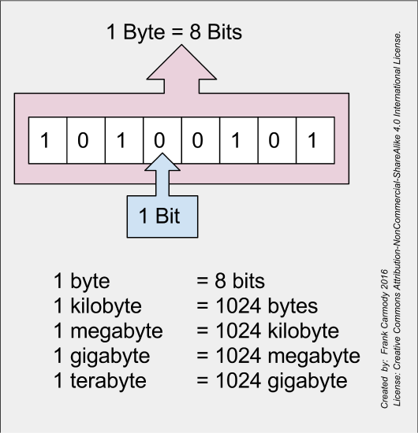
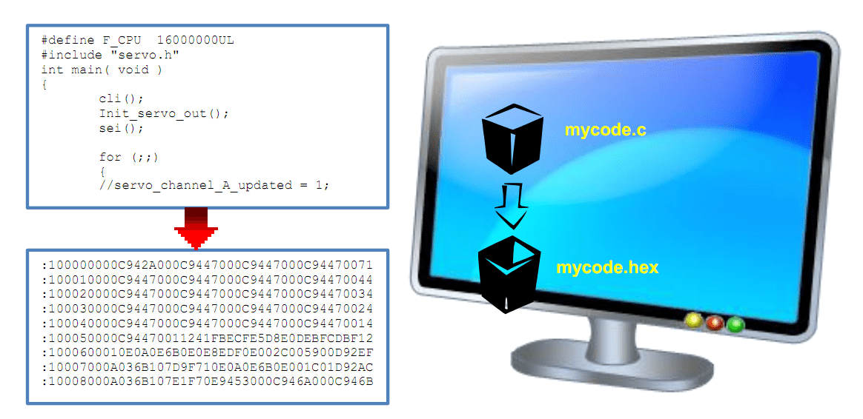

Slide 4
1. Data Types
Integer Types:
C provides different integer types such as int, short, long, and long long, which vary in size and range depending on the platform.
Unsigned integers (unsigned int, unsigned short, etc.) can hold only non-negative values.
Floating-Point Types:
Floating-point types represent real numbers with fractional parts.
The two main types are float and double, with double providing higher precision than float.
Character Types:
Characters are represented using the char type, which can store a single ASCII character.
Characters can be enclosed in single quotes, e.g., 'A', '1', '%'.
Derived Types:
Arrays: Arrays are collections of elements of the same data type. They are declared using square brackets, e.g., int numbers[10];.
Pointers: Pointers store memory addresses and are used for dynamic memory allocation and accessing array elements.
Structures: Structures allow you to group related data items under a single name.
Unions: Unions are similar to structures but allocate memory to hold only one member at a time.

Slide 5
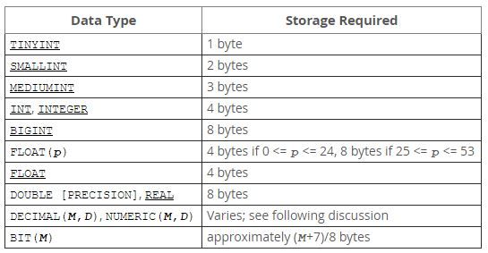
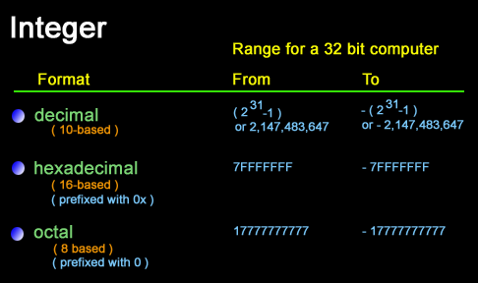

Slide 6
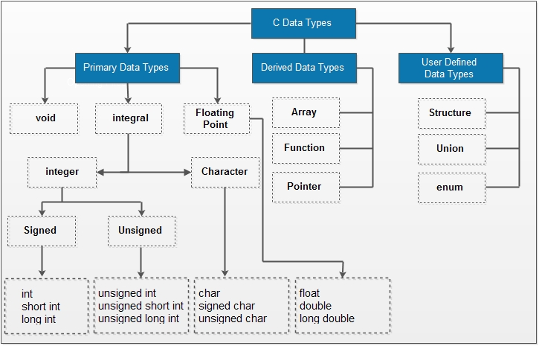

Slide 7
2. Variables and Constants
Variables:
Variables are named memory locations used to store data.
They must be declared before use, specifying their data type.
Variables can be modified during program execution.
Constants:
Constants are fixed values that do not change during program execution.
They can be defined using the const keyword, e.g., const int MAX_SIZE = 100;.
3. Operators
Arithmetic Operators: Perform arithmetic operations like addition, subtraction, multiplication, division, and modulus.
Relational Operators: Compare values and return true or false.
Logical Operators: Perform logical operations such as AND, OR, and NOT.
Bitwise Operators: Manipulate individual bits of operands.
Assignment Operators: Assign values to variables.
Increment and Decrement Operators: Increase or decrease the value of a variable by 1.
Conditional Operator (Ternary Operator): A shorthand for the if-else statement.

Slide 8
4. Control Flow
if-else Statement: Executes a block of code if a specified condition is true, otherwise executes another block of code.
switch Statement: Evaluates an expression and executes a block of code based on matching cases.
while Loop: Executes a block of code repeatedly as long as a specified condition is true.
do-while Loop: Similar to the while loop, but guarantees that the block of code is executed at least once.
for Loop: Executes a block of code a specified number of times.
5. Functions
Function Declaration and Definition: Functions are declared with a return type, name, and parameters (if any), and defined with the actual implementation of the function.
Function Call: Invoking a function by using its name and passing arguments (if any).
Return Statement: Used to return a value from a function to the caller.
Function Prototypes: A declaration of the function signature before its actual definition, allowing the compiler to verify function calls.

Slide 9
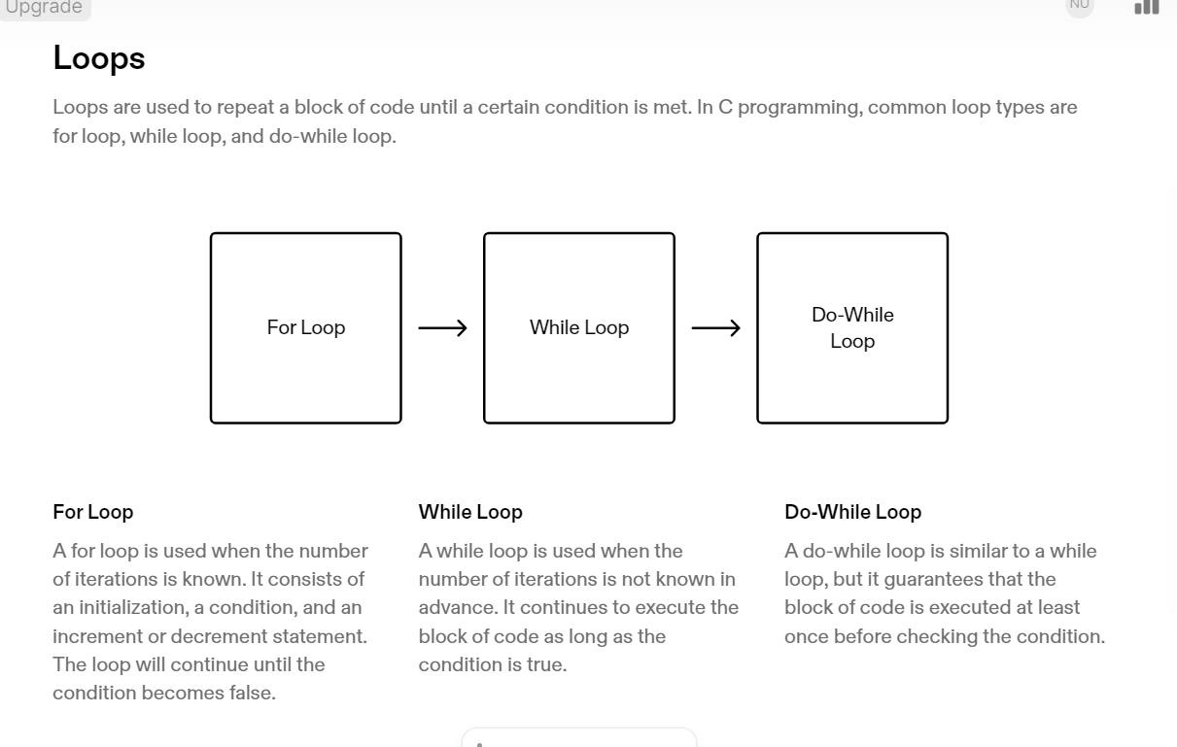

Slide 10
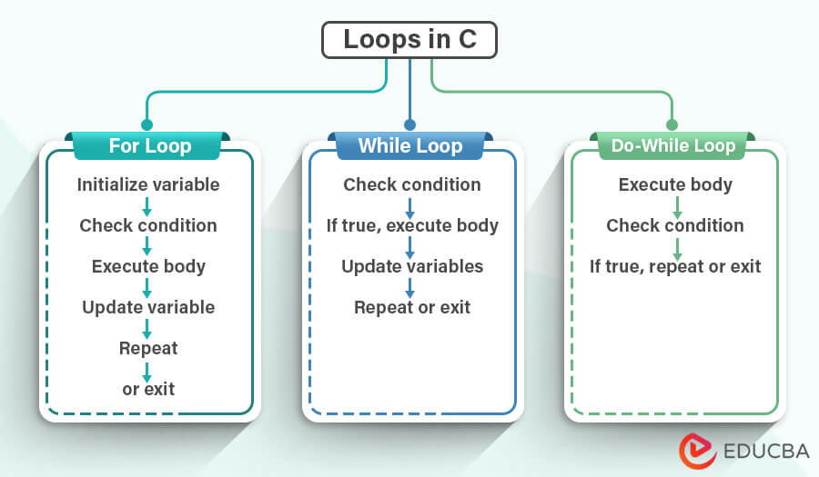

Slide 11
6. Input and Output
printf() Function: Used to print formatted output to the standard output (usually the console).
scanf() Function: Used to read formatted input from the standard input (usually the keyboard).
Formatted Strings: In printf() and scanf(), format specifiers like %d, %f, %c, %s are used to specify the data type of variables being printed or scanned.
7. Arrays
Declaration and Initialization:
Arrays are declared by specifying the data type of the elements and the array name, followed by square brackets containing the size of the array.
Example: int numbers[5]; declares an integer array named numbers with 5 elements.
Accessing Array Elements:
Array elements are accessed using zero-based indexing. For example, numbers[0] accesses the first element of the array.
Initialization:
Arrays can be initialized at the time of declaration by providing a comma-separated list of initial values enclosed in curly braces {}.
Example: int numbers[5] = {1, 2, 3, 4, 5};

Slide 12
8. Pointers
Declaration and Initialization:
Pointers are declared by specifying the data type of the variable it points to, followed by an asterisk *, and the pointer name.
Example: int *ptr; declares a pointer named ptr that points to an integer variable.
Referencing and Dereferencing:
Referencing: The address of a variable can be assigned to a pointer using the address-of operator &.
Dereferencing: The value stored at the memory address pointed to by a pointer can be accessed using the dereference operator *.
Pointer Arithmetic:
Pointers can be incremented or decremented to move to the next or previous memory location.
Example: ptr++; increments the pointer ptr to point to the next memory location.
9. Input and Output
1. printf() Function:
Used to print formatted output to the standard output (usually the console).
Format specifiers like %d, %f, %c, %s are used to specify the data type of variables being printed.
Example: printf("The value of x is %d\n", x);
2. scanf() Function:
Used to read formatted input from the standard input (usually the keyboard).
Format specifiers are used to specify the data type of variables being read.
Example: scanf("%d", &x); reads an integer value from the standard input and stores it in the variable x.

Slide 13
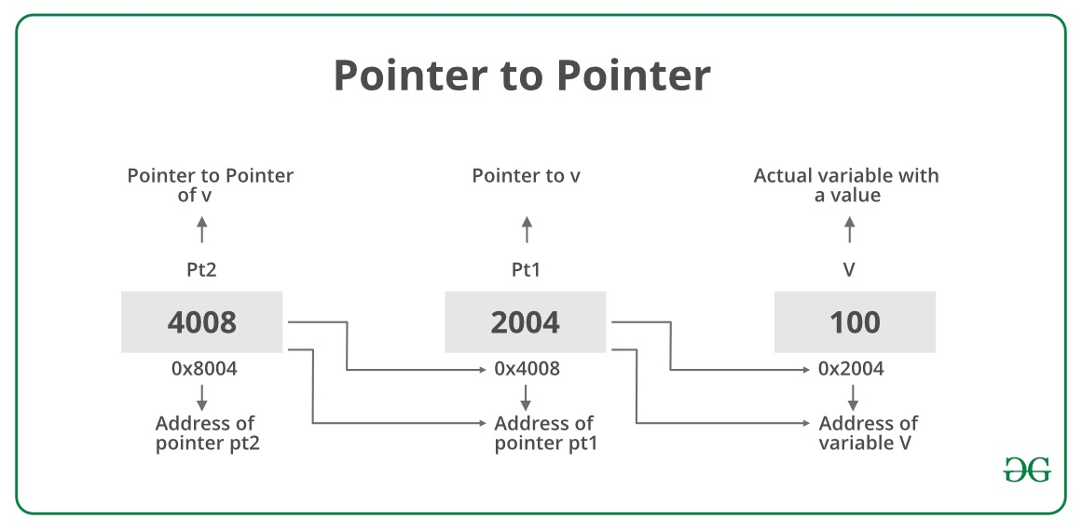
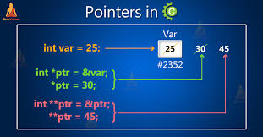

Slide 14
10. Standard Library Functions
stdlib.h: Provides functions for memory allocation, process control, and other utility functions.
math.h: Contains mathematical functions like sqrt(), pow(), sin(), cos(), etc.
string.h: Includes functions for string manipulation such as strcpy(), strcat(), strlen(), strcmp(), etc.
11. Structures
Definition:
Structures allow you to group together variables of different data types under a single name.
You define a structure using the struct keyword followed by the structure name and a list of member variables enclosed in curly braces.
Example:
struct Person { char name[50]; int age; float height; };
Accessing Structure Members:
You can access structure members using the dot . operator.
Example:
struct Person p; strcpy(p.name, "John"); p.age = 30; p.height = 6.0;

Slide 15
12. Unions
Definition:
Unions are similar to structures but allocate memory to hold only one member at a time.
All members share the same memory location.
Defined using the union keyword. Example:
union Data { int i; float f; char str[20]; }; Accessing Union Members:
Union members can be accessed in the same way as structure members using the dot . operator.
13. Input and Output
Formatted Input (scanf()):
%d: Integer input.
%f: Float input.
%lf: Double input.
%c: Character input.
%s: String input.
Formatted Output (printf()):
%d: Integer output.
%f: Float output.
%lf: Double output.
%c: Character output.
%s: String output.

Slide 16
14. File Handling
File Operations:
C allows you to perform file input and output operations using the fopen(), fclose(), fread(), fwrite(), fprintf(), and fscanf() functions. Example:
FILE *fp; fp = fopen("file.txt", "r"); if (fp != NULL) { fclose(fp); }
File Modes:
File modes specify the type of operations that can be performed on a file. Common modes include "r" (read), "w" (write), "a" (append), "rb" (read binary), and "wb" (write binary).
15. Dynamic Memory Allocation
malloc(), calloc(), realloc():
malloc(): Allocates memory block of specified size.
calloc(): Allocates memory block for an array of elements and initializes them to zero.
realloc(): Resizes the memory block allocated by malloc() or calloc().
Example:
int *ptr; ptr = (int *)malloc(10 * sizeof(int)); if (ptr != NULL) { // Use allocated memory free(ptr); // Free allocated memory }

Slide 17
DATA STRUCTURES

Slide 18
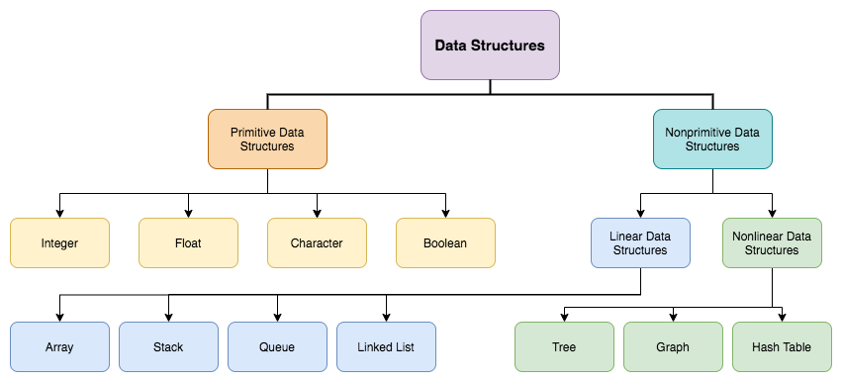

Slide 19
Arrays: Ordered collection of elements stored in contiguous memory locations. Random access is efficient.
Linked Lists: Elements are stored in nodes, each containing data and a pointer to the next node. Dynamic size, efficient insertion/deletion.
Stacks: LIFO (Last In, First Out) data structure. Elements are inserted and removed from the same end (top).
Queues: FIFO (First In, First Out) data structure. Elements are inserted at the rear and removed from the front.
Trees: Hierarchical data structure with a root node and child nodes. Examples include binary trees, AVL trees, red-black trees.
Graphs: Represent connections between pairs of elements. Vertices/nodes connected by edges.
Hash Tables: Data structure that implements associative arrays or mappings of key-value pairs. Efficient for lookup, insertion, and deletion.
Heaps: Complete binary tree where every parent node has a value less/greater than or equal to its children (min/max heap).
Priority Queues: Abstract data type similar to a regular queue or stack, but each element has an associated priority.

Slide 20
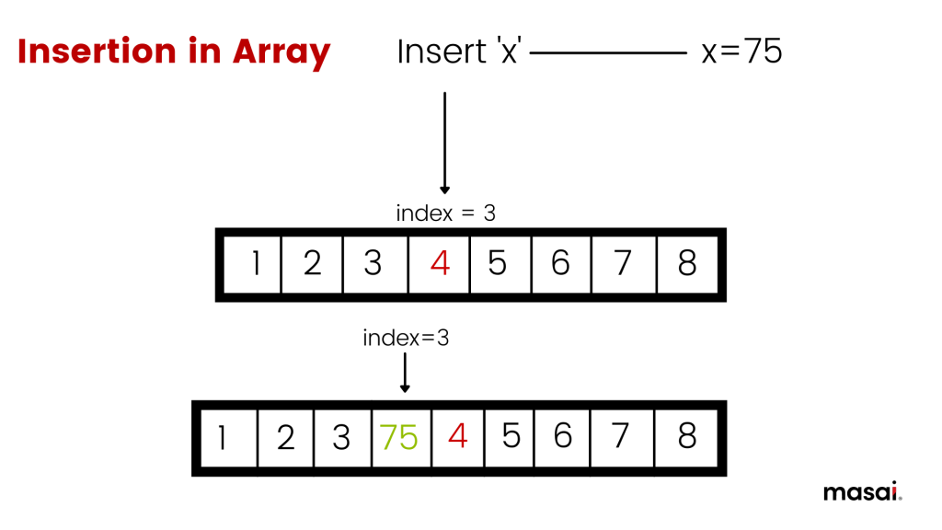
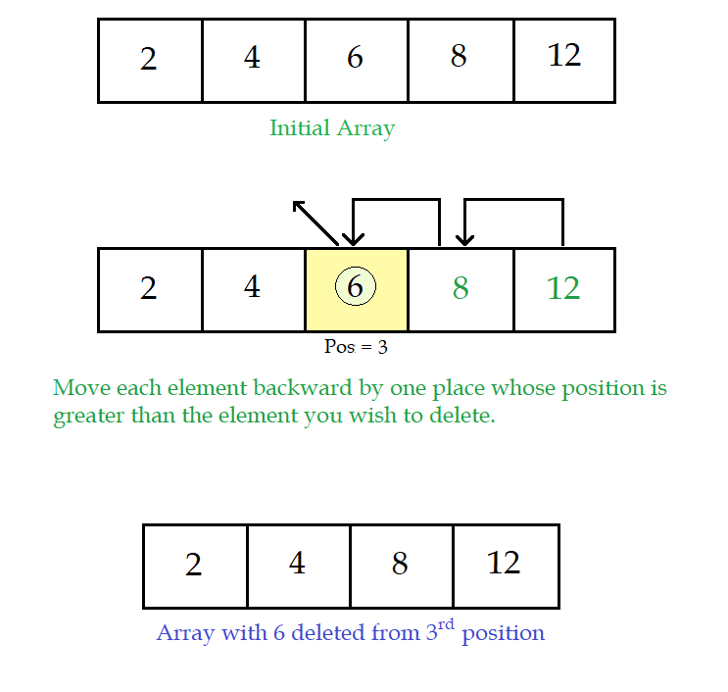
DELETION IN ARRAY

Slide 21
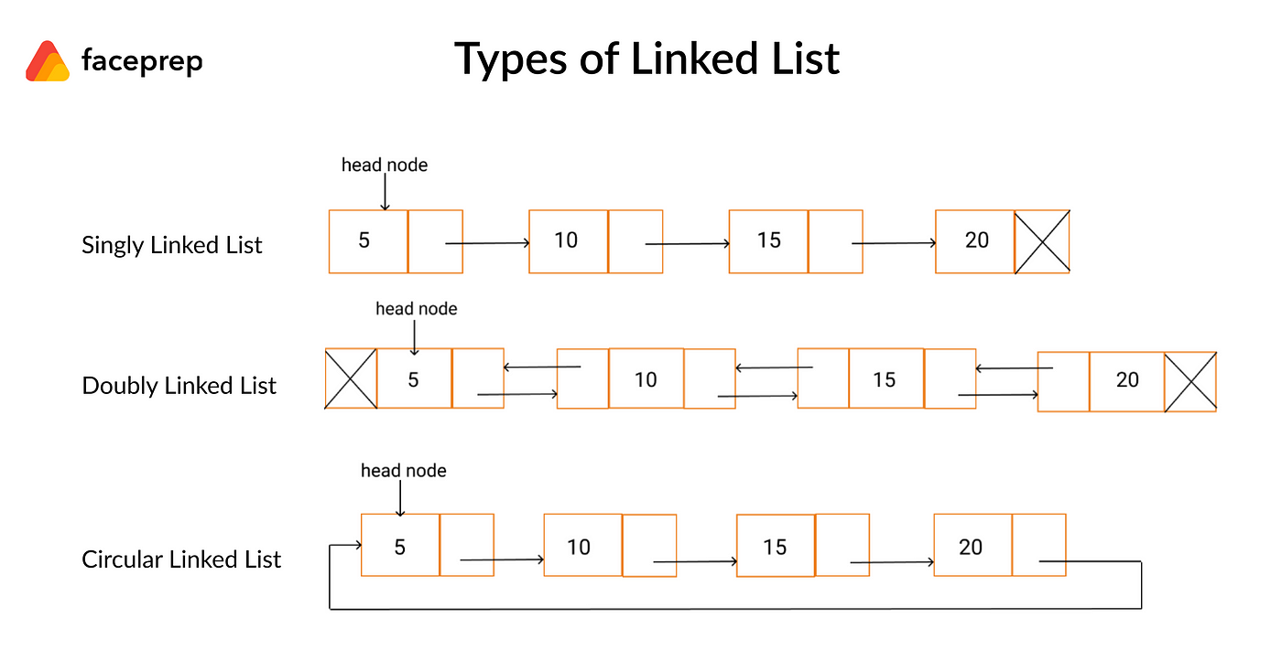



Slide 22
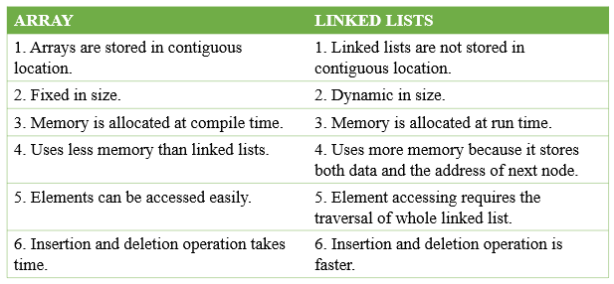
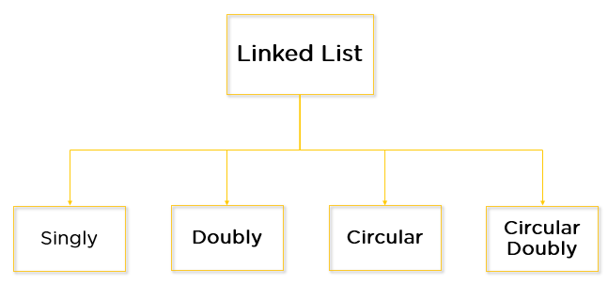
Ganavi M

Slide 23
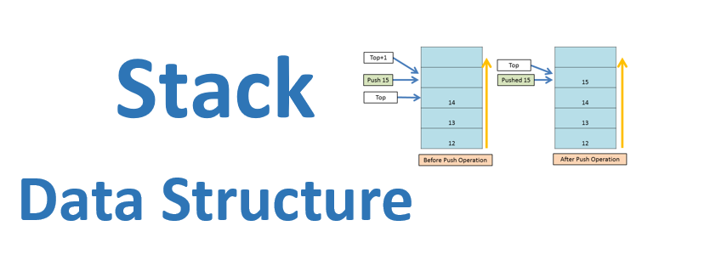
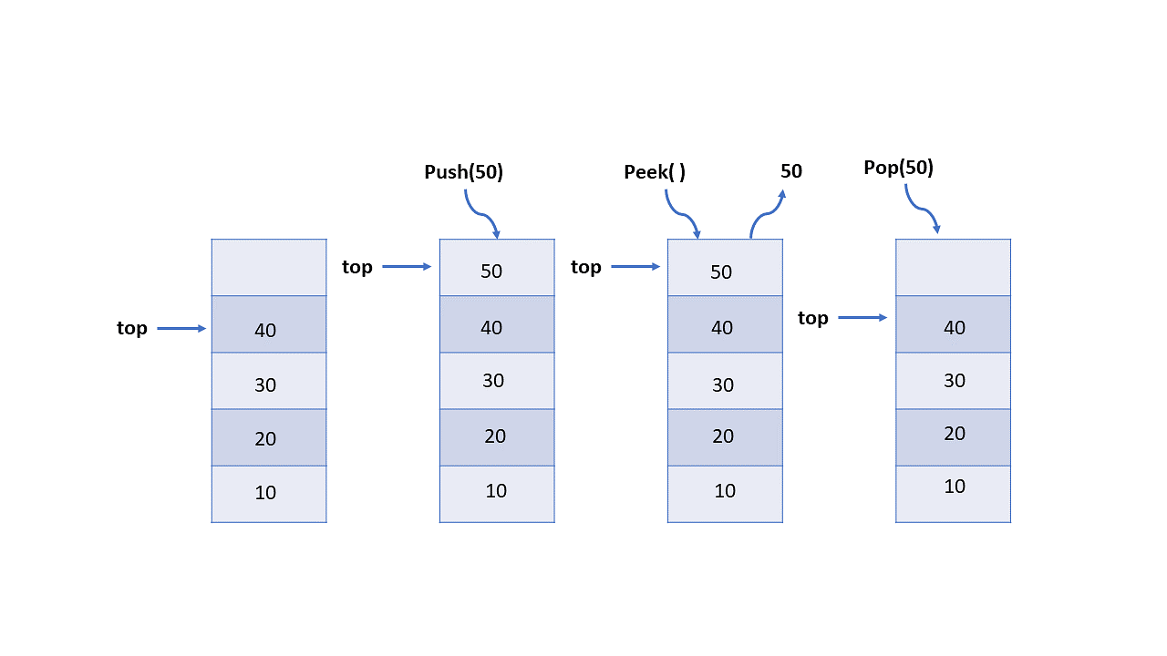

Slide 24
The main functions in the Stack ADT are (S is the stack)
boolean isEmpty(); // return true if empty
boolean isFull(S); // return true if full
void push(S, item); // insert item into stack
void pop(S); // remove most recent item
void clear(S); // remove all items from stack
Item top(S); // retrieve most recent item
Item topAndPop(S); // return & remove most recent item
The main functions in the Queue ADT are (Q is the queue)
void enqueue(o, Q) // insert o to back of Q
void dequeue(Q); // remove oldest item
Item getFront(Q); // retrieve oldest item
boolean isEmpty(Q); // checks if Q is empty
boolean isFull(Q); // checks if Q is full
void clear(Q); // make Q empty
FUNCTIONS IN STACK AND QUEUE

Slide 25
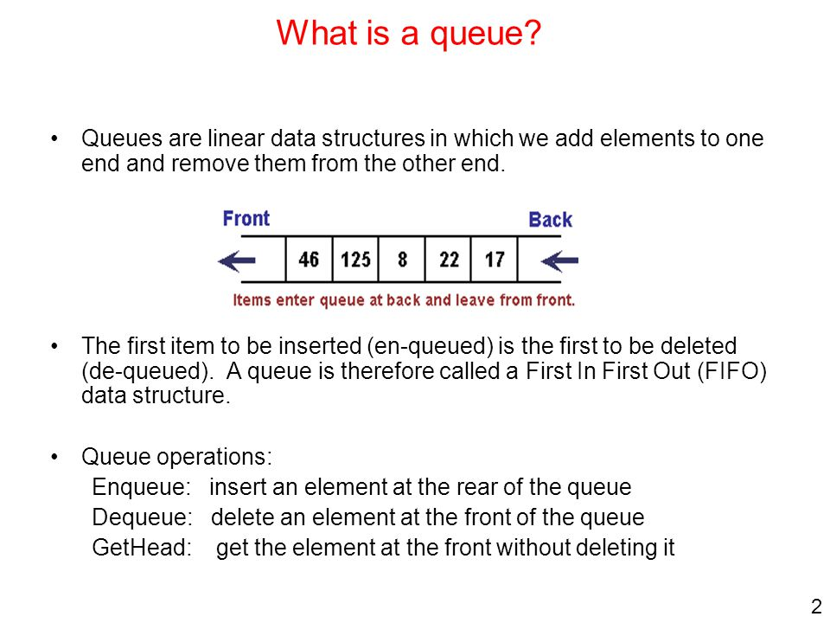
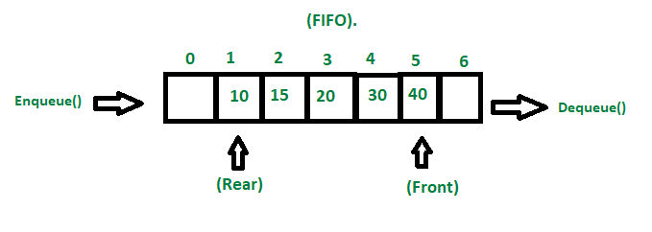

Slide 26
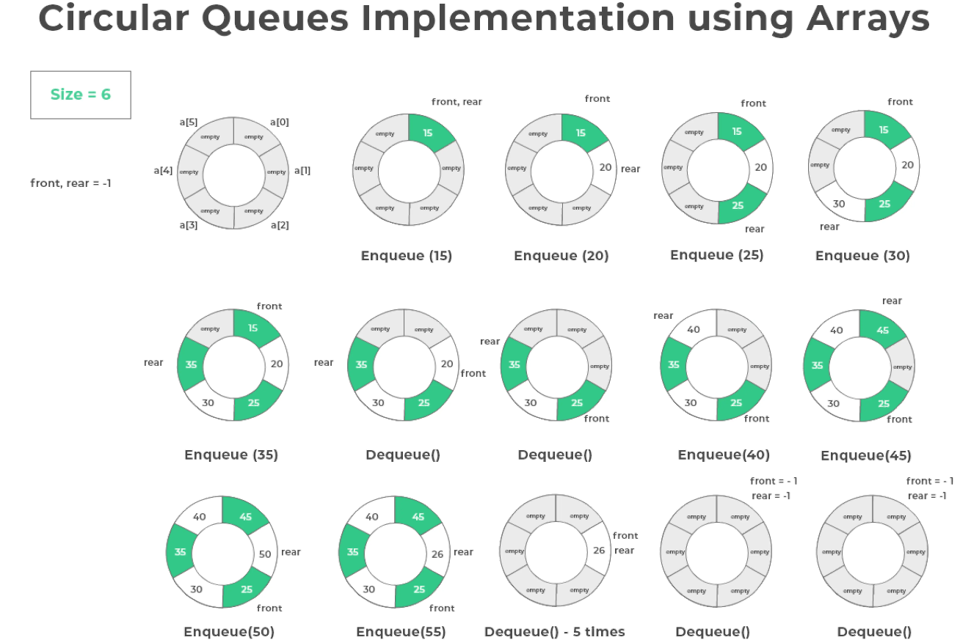

Slide 27
Thank you

